Slide 1
Object Orientated Programming
Error Handling
Week 10 – Session 1
Francis Magann (francis.magann@ncirl.ie)
Frances Sheridan
Carole McGloughlin
Version: 1.0
Date: 06/04/2013

Slide 2
Object Orientated Programming
Error Handling
Introduction
Exceptions
Unchecked
Checked
Catching an Exception
Catching Multiple Exceptions
Passing the Exception
Syntax Errors

Slide 3
Introduction
Users have high expectations of software programs.
Users will also use software programs in unexpected ways.
Due to design errors or coding errors, our programs may fail in unexpected ways during execution.
That is why we a programmers must,
Produce quality Java code that does not fail unexpectedly; and
Design error handling into our Java code.

Slide 4
Introduction: Errors and Error Handling
An Error is any unexpected result obtained from a program during execution.
Unhandled errors may manifest themselves as incorrect results or behavior, or as abnormal program termination.
Errors should be handled by the programmer, to prevent them from reaching the user.

Slide 5
Introduction: Typical Causes of Errors
Memory errors e.g. objects or memory incorrectly allocated, memory leaks, null pointer etc.
File system errors e.g. file not found, disk is full etc.
Network errors e.g. network is down, URL does not exist etc.
Calculation errors e.g. divide by 0 etc.
Array errors e.g. accessing element –1, or index out of bounds etc.
Conversion errors e.g. trying to convert “some text” to a number etc.
Others?

Slide 6
Exceptions
An exception is a representation of an error condition or a situation that is not the expected result of a method.
Exceptions are built into the Java language and are available to all program code.
Exceptions isolate the code that deals with the error condition from regular program logic.
There are two types of exceptions,
Unchecked; and
Checked.

Slide 7
Java Exception Class Hierarchy
ClassNotFoundException
Exception
CloneNotSupportedException
IOException
ArithmeticException
AWTException
NullPointerException
RuntimeException
Object
Throwable
IndexOutOfBoundsException
…
NoSuchElementException
LinkageError
…
Error
VirtualMachoneError
AWTError
Checked
…
Unchecked

Slide 8
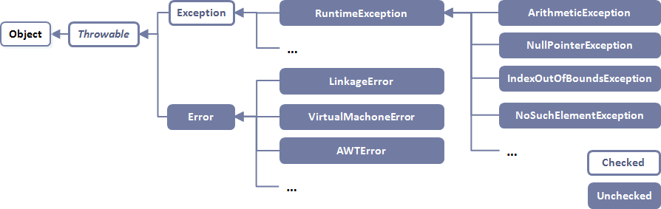
Unchecked Exceptions
Unchecked exceptions represent error conditions that are considered “fatal” to program execution.
You do not have to do anything with an unchecked exception.
Your program will terminate with an appropriate error message.
Checked exceptions include errors such as “array index out of bounds”, “file not found” and “number format conversion”.
Unchecked exceptions include errors such as “null pointer”.
Unchecked exceptions are inherited from the core Java classes Error and RuntimeException.
May be considered Runtime Errors because JVM environment detects an operation is impossible to carry out while the code is running.

Slide 9
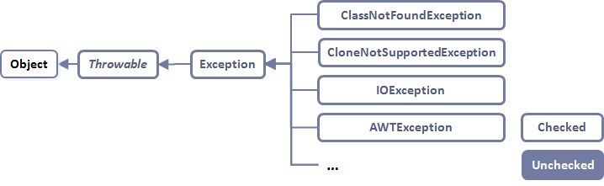
Checked Exceptions
Checked exceptions are inherited from the core Java class Exception.
Checked exceptions are frequently considered “non fatal” to program execution.
Checked exceptions must be handled in your code, or passed to parent classes for handling.
May be considered Logical Errors as they occur when the code doesn't perform the way it was intended to.

Slide 10
Exception Handling
Exception handling is accomplished through the try – catch mechanism, or by a throws clause in the method declaration.
For any code that throws a checked exception, you can decide to handle the exception yourself, or pass the exception “up the chain” to a parent class or calling method.

Slide 11
Catching Exceptions
Wherever your code may trigger an exception, the normal code logic is placed inside a block of code starting with the try keyword.
After the try block, the code to handle the exception should it arise is placed in a block of code starting with the catch keyword.
You may also write an optional finally block. This block contains code that is ALWAYS executed,
either after the try block code, or
after the catch block code.
Finally blocks can be used for operations that must happen no matter what e.g. clean-up operations such as closing a file.

Slide 12
Catching an Exception
Normal program code that is monitored for the occurrence of an exception are contained within a try block.
Code within a catch block catch the exception and handle it.
try {
… normal program code } catch(Exception e) {
… exception handling code }
finally {
… always execute this code
}
public class ExceptionSampleApp {
public static void main(String[] args) {
int x = 1;
int y = 0;
try {
System.out.println("x/y= " + x/y);
}
catch(Exception e) {
System.out.println("Exception: " + e.getMessage());
}
finally {
System.out.println("Done");
}
}
}

Slide 13
Catching Multiple Exceptions
If more than one exception can occur, then we use multiple catch clauses.
When an exception is thrown, each catch statement is inspected in order, and the first one whose type matches that of the exception is executed.
After one catch statement executes, the others are bypassed,
public class ExceptionSampleApp {
public static void main(String[] args) {
int x = 1;
int y = 0;
try {
System.out.println("x/y= " + x/y);
}
catch(ArithmeticException aex) {
System.out.println("ArithmeticException: " + aex.getMessage());
}
catch(Exception e) {
System.out.println("Exception: " + e.getMessage());
}
}
}

Slide 14
Passing the Exception
In any method that might throw an exception, you may declare the method as “throws” that exception, and thus avoid handling the exception yourself,
Passing multiple exceptions is a comma separated list,
public void myMethod throws IOException {
… normal code with some I/O }
public static void openFile(String fileName) throws FileNotFoundException, IOException {
File file = new File(fileName);
BufferedReader reader = new BufferedReader(new FileReader(file));
}

Slide 15
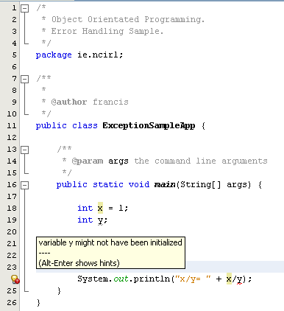
Syntax Errors
Syntax Errors: Arise because the rules of the language have not been followed,
They are detected by the compiler.
NetBeans will highlight such errors in red and often prompt the best action to resolve.
NetBeans will highlight a syntax error in red
Place your mouse over this icon to display a hint about resolution

Slide 16
Summary
Exceptions are a powerful error handling mechanism.
Exceptions in Java are built into the language.
Exceptions can be handled by the programmer (try-catch), or handled by the Java environment (throws).
Syntax errors are caught by the Java compiler.

Slide 17

Questions

